Slide 1
End of Summer Time by Roger Hall
Show Summary
Relaxed Performance: Tue 1 July 7:00pm
Pre-show Demonstration: Tue 1 July 6:30pm

Slide 2
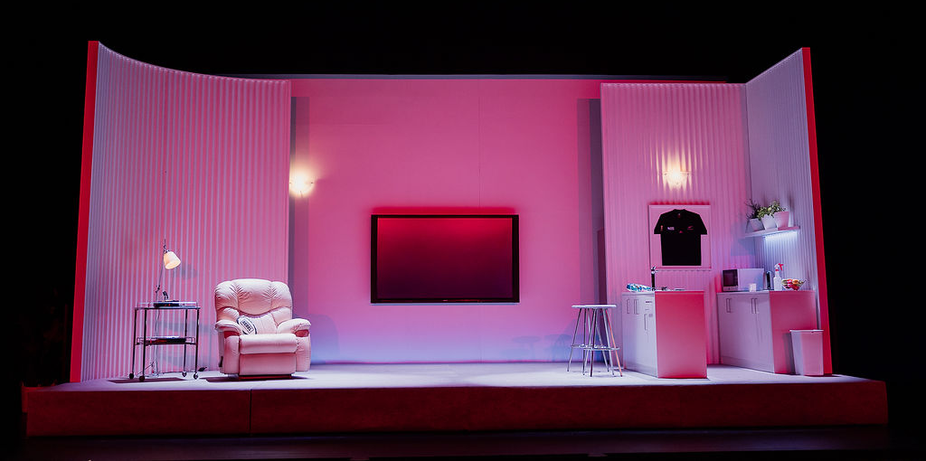
Auckland Theatre Company presents End of Summer Time by Roger Hall
Setting: Auckland, New Zealand (2019-2023). A modern apartment with white walls and a TV screen that displays images throughout the show.
Main Character: Dickie Hart - A 70-something retired farmer from Wellington, now living in Auckland.

Slide 3
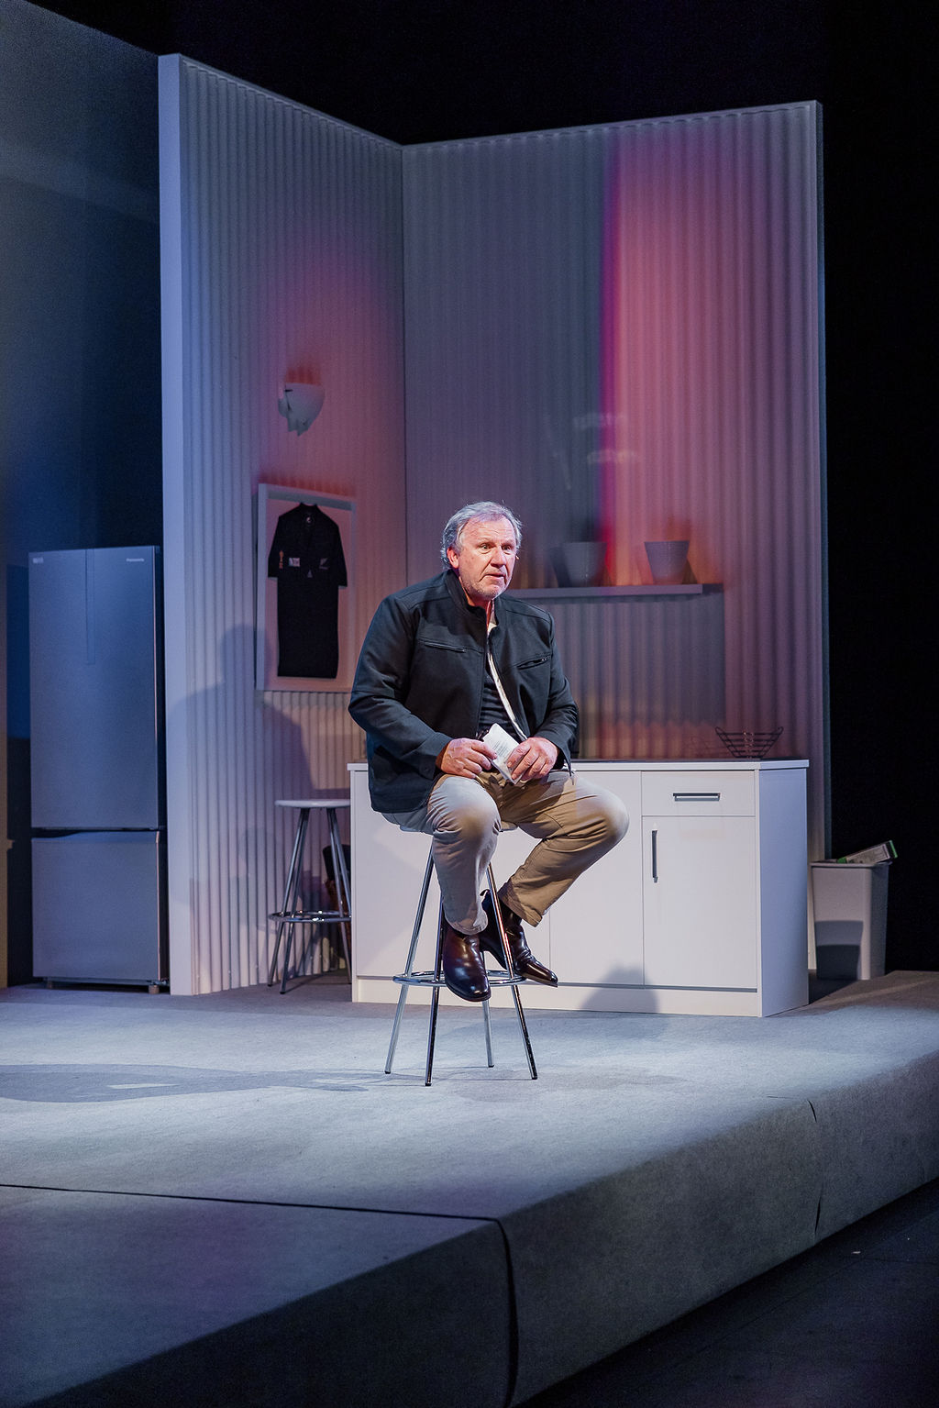
Production Notes:
Performance notes: This is a one-person show. Dickie portrays all characters by changing his voice, posture, and mannerisms. He speaks directly to the audience as if talking to himself. The performance is highly physical and emotional, with sudden shifts between loud excitement and quiet reflection.

Slide 4
A note on Spoilers:
This document includes spoilers. If you don’t want to know details about the show, don’t read any further.
Reach out to Sam Phillips, Auckland Theatre Company’s Head of Learning and Participation, on sam@atc.co.nz. Sam will also be at the ASB Waterfront Theatre on Tuesday 6 May, and will present the pre-show demonstration at 6.30pm.

Slide 5
The Move to Auckland
The show begins with rugby footage on the TV and Dickie entering with loud claps and cheers. He's watching the All Blacks and is clearly a devoted fan. As he celebrates, he begins telling us his story.
Dickie explains he never thought he'd end up in Auckland - "the one place in New Zealand I swore I'd never live in!" He shifts into playing his wife Glenda, changing to a higher-pitched voice and rigid posture. She insisted they move to be near their sons Grant and Brian and the grandchildren. Despite Dickie's protests about Auckland's traffic, crowds, and expenses, they move to Auckland.

Slide 6
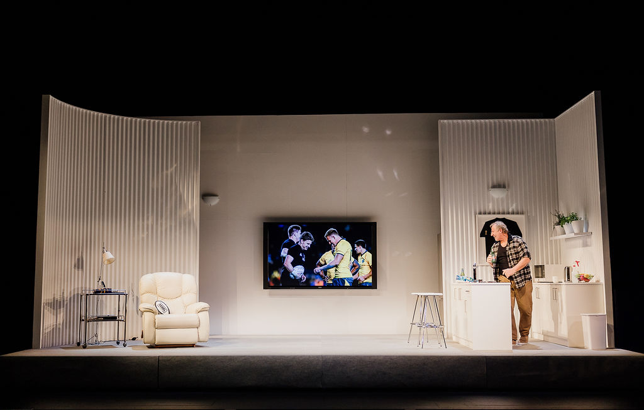

Slide 7
Sea View Apartment
Dicky and Glenda move into a fifth-floor apartment at "Sea View" complex on the North Shore.
Dickie shows us around. He complains about apartment living versus having a proper garden. The kettle boils during this scene and he makes himself tea.
Taking grandchildren Jake and Emma to the pool, there is a splash as they enter through the locked gate. The lighting changes to blue.
Dickie meets Stephanie from apartment 2A - he portrays her by putting on sunglasses and speaking in a high-pitched voice. She's a widow on the Body Corporate who flirts with him. When Emma pretends to drown, Dickie jumps in fully clothed to "save" her.

Slide 8
Filling Empty Days
Dickie struggles with retirement. Glenda has yoga, book club, and theatre friends, but Dickie has nothing. She sends him to the library to collect her book club selection. The lighting turns warm orange as he meets librarian Sandra, who convinces him to join and borrow a book. He excitedly chooses "Meads" about rugby legend Colin Meads. Glenda is horrified it will appear on her borrowing record.
The apartment lights change to a strong blue colour on the walls, as waves and birdsong play.
Dickie describes Takapuna Beach - families, dog walkers, swimmers, paddle boarders, and annoying jet skis (their droning sound grows louder). He reflects on missing his farm dogs while watching city people with their "stupid little things."

Slide 9
City Driving Disaster
Glenda sends Dickie to collect a dinner set from Smith & Caughey’s.
Dickie sits on a stool to indicate he’s driving a car.
In the car, a GPS voice confuses him with "Turn South" instead of "left."
Car horns and traffic plays. Dickie struggles with which lane to use on the Harbor Bridge during wind gusts. In the Civic car park, his voice echoes as he descends level after level. Later, he can't find his Ute or remember which floor he parked on.
Back in the apartment the phone rings - it's Fergus Dexter from apartment 6B, the Body Corporate chairman. They meet for coffee.
Fergus wants another man on the committee to outvote the women who only care about flowers in the foyer. Dickie reluctantly agrees to join.

Slide 10
Bus Trip and Ferry Adventure
Dickie braves the bus to the city.
Downtown, he reminisces about 1950s Auckland - the "mighty Civic" theatre with its Arabian palace interior and Wurlitzer organ. Now Queen Street is all students and fast food.
On the ferry to Devonport, he meets a knowledgeable woman who shares her sandwich and explains a waterfront sculpture that looks like a state house. She's Dr. Linda Burrows, a botany professor who suggests climbing Auckland's volcanoes.

Slide 11
Wellington Trip
Returning to Wellington to collect Glenda's pot plants, Dickie battles fierce Wellington wind.
The Body Corporate committee meets.
They discuss the pigeon problem and Dickie offers to shoot them with his air gun.
Janet and Shirley want to renovate the foyer with new furniture and art. Fergus, Betty, and Dickie vote against the expense.

Slide 12
School Holiday Adventures
A school bell rings as Dickie collects Jake and Emma for school holiday care.
Blue light indicates they're in the car as he takes them up Mt Eden/Maungawhau.
After Emma and Jake complain about their vegan lunches (chickpea and fennel sandwiches), over successive days Dickie takes them to McDonald's, then Burger King, then KFC.
Their final adventure is the Riverhead ferry - they discover how vast Auckland Harbor is and enjoy a proper restaurant meal.

Slide 13
World Cup Disappointment
Glenda offers to accompany Dickie to the 2019 Rugby World Cup in Japan - she'll see gardens while he watches games. Dickie discovers his old mate Morrie has died, and Fergus is leaving for an American university position. Dickie watches from home as the All Blacks lose to England in the semi-final after England's controversial V-formation during the haka. He throws chips in frustration. South Africa wins the final - the team the All Blacks beat in their first match.
The act ends with Dickie saying "And then COVID struck." Loud upbeat music plays ironically as the interval begins.

Slide 14
Interval:
The red curtain returns.
The audience lights will come on, and you can take a break, use the toilet, and get a drink or snack from the bar, or remain in your seat. You can use the breakout space to relax away from the crowds. The break will last about 15 minutes.
During the interval, if you are in the foyer you will hear a recorded “Bing bong” sound and an announcement to return to your seats.
When the performance is ready to begin, audience lights will fade down.

Slide 15
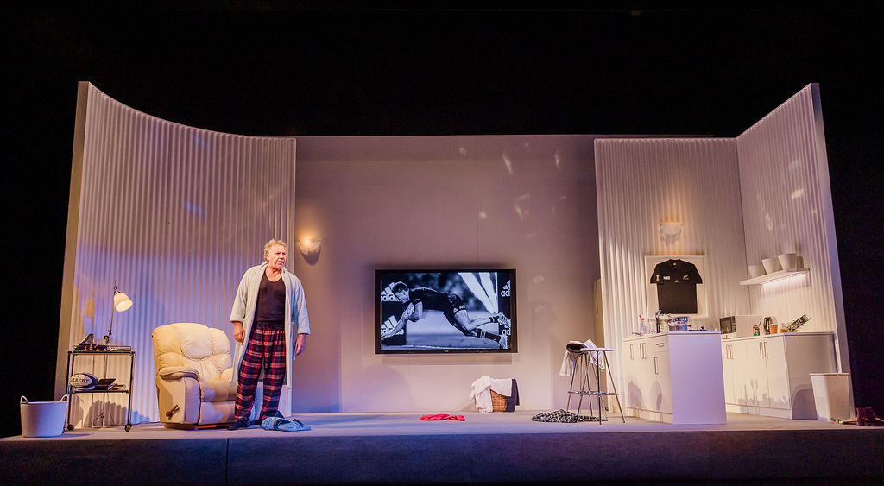
A Changed Man
"Nowhere Man" plays as Dickie enters completely dishevelled - pyjamas, dressing gown, bandaged head from falling down stairs, blue crocs. The apartment is chaotic with clothes and dirty dishes everywhere.
He explains the head injury happened falling down stairs in his crocs - "Always a stupid thing to do." He demonstrates his balance exercises, standing on one leg, admitting it's "bit late, really."

Slide 16
Pandemic Life
Dickie recounts COVID's progression from distant threat to New Zealand reality. He describes China building hospitals in ten days, the Black Caps playing cricket in empty stadiums, panic buying at supermarkets (fighting over toilet rolls), and the country going into lockdown. He demonstrates the new rituals - putting on a mask, obsessive hand washing for thirty seconds while Glenda times him. Social distancing means no one can share lifts or visit other apartments.

Slide 17
ANZAC Day
When discussing ANZAC Day, a trumpet begins playing. The lighting shifts to dark blue with red near the floor, poppies appear on the TV screen. People stand at their gates at dawn since large gatherings are banned. Dickie mentions teddy bears in windows and dogs being walked multiple times daily - "when we reach for their leads they run and hide."

Slide 18
Glenda's Death
Lockdown ends but the Delta variant arrives. Both Dickie and Glenda catch COVID, likely from her book group friend who stayed with American anti-vaxxers.
Glenda goes to hospital but dies within two days.
Sorrowful music plays as Dickie wanders the stage. There's no funeral and the family can't visit - they're locked down in their cities. Dickie is alone.

Slide 19
Aftermath and Decline
A doorbell rings - food delivery arrives. Dickie explains how the family debated putting him in a retirement home, calculating costs at Ryman's before deciding he could manage alone with grocery deliveries. Stephanie rings offering condolences, then immediately asks about buying Glenda's Mazda. Other friends call wanting Glenda's coffee loyalty cards.
Dickie describes his physical and mental decline. He hobbles, horrified at the thought of needing a walker. He stops going out, and the less exercise he does, the less fit he becomes.
Morning routines exhaust him - checking his body's pains, deciding whether to get up, wearing yesterday's clothes from the floor.
Dickie lets all Glenda's pot plants die. Going through her belongings, he finds her Birthday Book full of crossed-out names and wonders who's next. Mail piles up unopened on the hall table.

Slide 20
2023 Disasters
Celebratory music plays and Dickie announces that 2023 is the year things would get better.
Instead, Auckland Anniversary weekend brings catastrophic flooding - ten inches of rain per day. Thunder and heavy rain sounds play while the TV shows storms.
The apartment lighting changes to pale blue with lightning effects.
Grant phones - their house is red-stickered after the Pohutukawa tree crashed through the roof. Dickie gives them his Ute. Cyclone Gabrielle follows, devastating Hawke's Bay and Gisborne with more forestry slash.

Slide 21
Census Crisis
Vince bangs on the door insisting Dickie must complete the census.
Days later, more knocking - this time it's Fergus, back from America.
He surveys the apartment's chaos: mail piled high, dishes in sink, clothes everywhere, Dickie's last meal of stewed plums on toast abandoned on the bench.
Fergus only comments on the landline phone being a waste of money. Dickie explains he needs it to ring his cell phone when he loses it.
Fergus insists Dickie clean up and shave before they meet for coffee. Later, they work through the census together.
The bar's drag queen night begins - "I Will Survive" blasts as lights flash multicolour with a disco ball on the TV screen. They all sing "Dancing Queen" together.

Slide 22
Driving Test Renewal
Dickie must pass a cognitive test to keep his license. At the doctor's office, he makes the same joke about his name (Dickie Hart - check my heart) and tells his familiar story about Uncle Bert fooling the eye test with one eye. The nurse tests his memory with word lists and counting backwards from 100 in sevens. When asked to name supermarket items for one minute, elevator music plays as Dickie rapidly lists: toilet paper, soap, toothpaste, toothbrush, pills, bacon, eggs, cereal, bread, teabags, coffee, Tam-tams, more bacon, more eggs, bangers, cheese, tomato sauce, tinned fruit, spaghetti, salt, pepper, sugar, butter, bananas, tomatoes, peanut butter, soup, ice cream, milk, Steinlager, multiple brands of crisps. A celebratory trumpet blasts as he holds up his renewed license triumphantly.

Slide 23
Return to Life
With Fergus's friendship and his renewed license, Dickie transforms. He establishes routines, cleans regularly, keeps himself "spruced up," meets Fergus weekly for coffee, and returns to walking. He still wishes he had a dog.
It's April, the end of summer time. Dickie walks along Takapuna Beach in the evening. The apartment's side walls pull aside and the back wall lifts, revealing a projection of the beach. He observes families of all cultures and languages taking selfies, digging sand channels.

Slide 24
